Slide 1

Palatine Hill Water District
Public Hearing - Water Rate Increase
February 11, 2020, 5:30 p.m.
Riverdale Grade School Library

Slide 2
01
Water System Overview
02
Current and Historical Water Rates
03
Need for Water Rate Increase
04
Alternatives Considered
05
Proposed 2020 Water Rate Increase – Typical Bill Impacts
Agenda
06
Future Water Rate Considerations
05
07
07
Q&A
08
Notes:
MGM/TCL

Slide 3
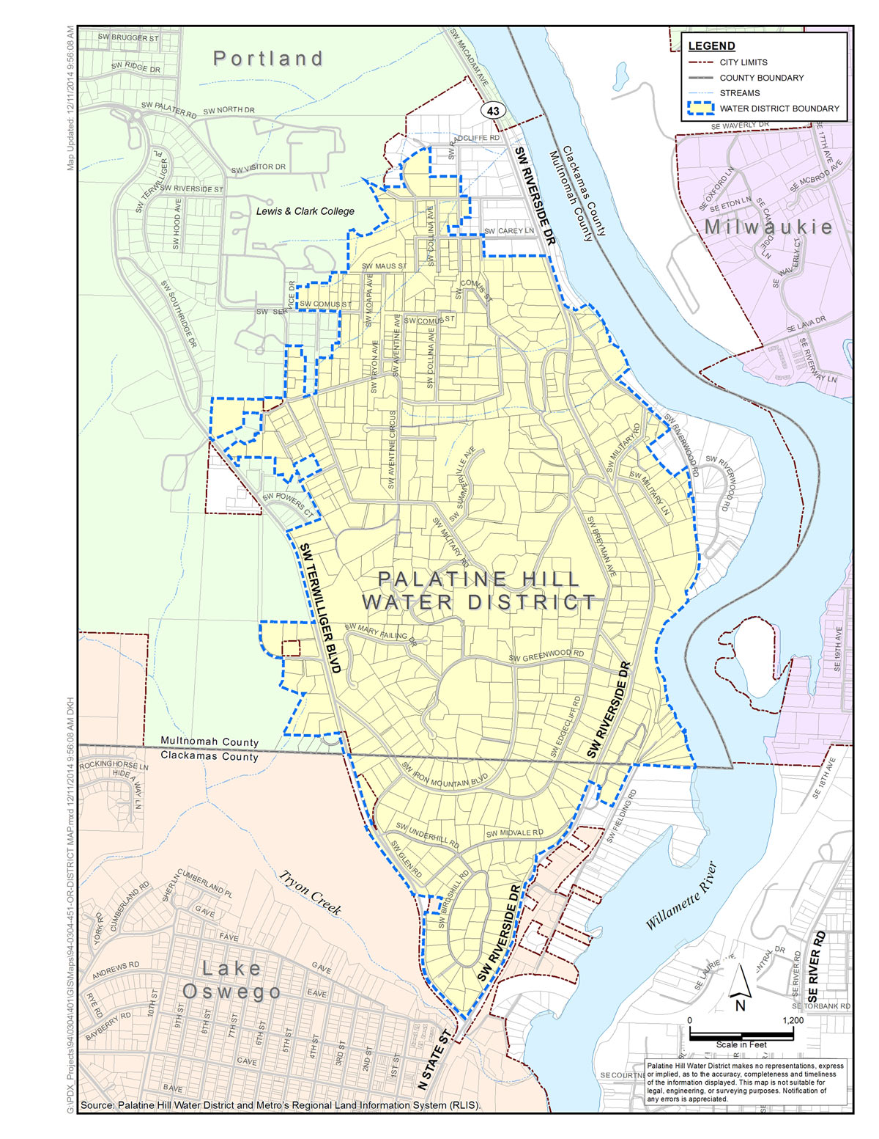
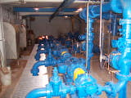
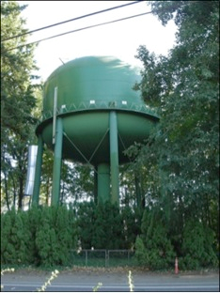
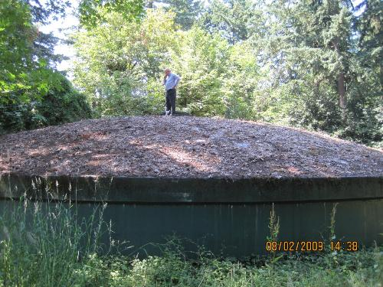
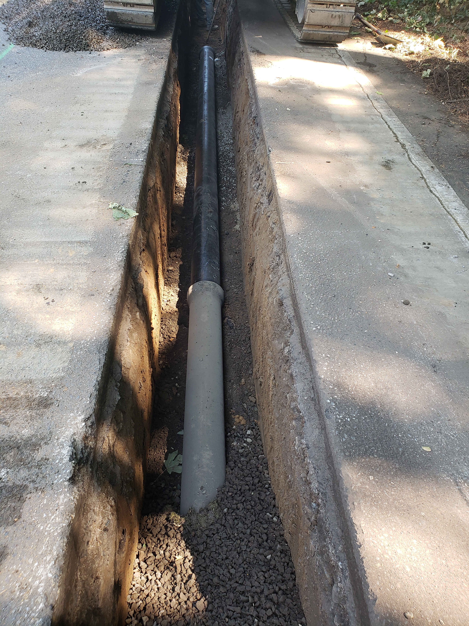
Water System Overview
Notes:
620 Residential Services. 2 Reservoirs. Pump Station. Master Meter Connection to PWB. ~12.5 miles of pipe.

Slide 4
Current Water Rate Structure
  Base Charge (includes first 10 CCF)
  3 tier usage charge
  $100 for first 10 CCF
  $4.25 per CCF for 10-50
  $5.00 per CCF for 50-100
  $5.75 per CCF over 100
Previous Rate Increases:
  2016 (current rates)
  2011
  2009
  2006
Current and Historical Water Rates

Slide 5
Inflationary Impacts
  ~10% increase in Consumer Price Index since 2016
Increased System Renewal & Replacement Costs
  Construction costs (materials and labor) increasing faster than inflation
  25% increase since 2015
Wholesale Water Rates
  20 Year Portland Water Bureau Wholesale Contract
    Rate Considers Peak Season and Peak Daily Usage
  Average Annual Rate Increase (2016 to 2019) ~ 3% (~13% Cumulative)
  Projected Cumulative Rate Increase (2019 to 2023) ~ 281%
    Washington Park Reservoir (2020-21) -- >$200M
    Willamette River Crossing (2020-21) - ~$90M
    PWB Filtration Plant (2025 +/-) -- >$800M
    Loss of Wholesale Customer Base (Tigard, TVWD, others…)
Need for Water Rate Increase

Slide 6
Reduced System Improvement Fund Transfers
  Delays system improvements
  Increased Risk to Service Reliability
  Increased O&M Cost
Uniform Increase in Base and Usage Tiers
  All customers receive a similar increase in bill
  Doesn’t equitably reflect cost of service
Increase Base and Usage Tier Charges to Reflect Cost of Service
  Base charge increase -- water system fixed costs
  Incrementally larger increase for usage tier – wholesale rate impacts
  Typical bi-monthly bill increase for all customers: 40% to 50%
Other Alternatives
  Change supply source…
  Bond for system improvements
Alternatives Considered

Slide 7
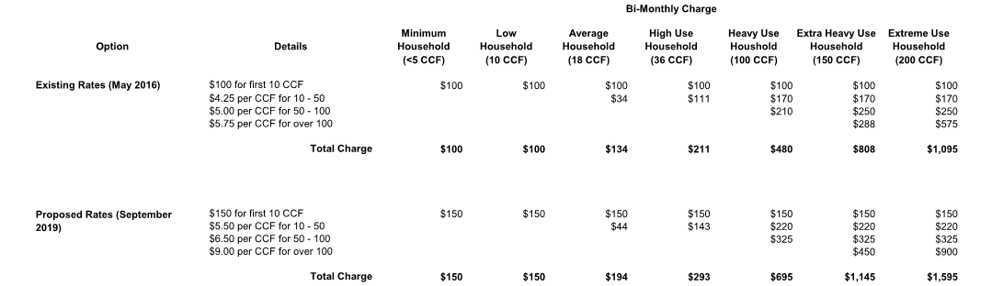
Rate Increase – Typical Monthly Bill Impact

Slide 8
PWB Wholesale Rate Forecast
  Currently forecasted wholesale rate increases will require the District to raise rates more frequently
Changes to PWB Wholesale Contract
  Contract expires in 2026
  Wholesalers currently evaluating alternative contract structure
System Renewal and Replacement Investments
  Aging infrastructure (1920s and 1950s Cast Iron Pipe)
Future Rate Considerations

Slide 9
Q&A

Slide 10
Thank you!

Slide 11
Rate Comparison Data
Notes:
Portland – Large customer base. Commercial/industrial/multi-family services.

